Slide 1

AI Sustainability
Stanley Ou, Andy Ouyang, Joyce Lam

Slide 2
Background
1
BNY Mellon emissions saw small increase in emissions from data center energy use and carbon-intensive utility grids in 2023
2
Due to digital nature of operations and services, data centers account for 47% of the electricity used by BNY globally.
3
In 2023, 100% of the electricity used to power BNY Mellon’s global locations, including data centers, was backed by renewable sources
Notes:
Operational emissions from buildings and data centers
3 Energy-related upgrades will continue to further reduce emissions

Slide 3
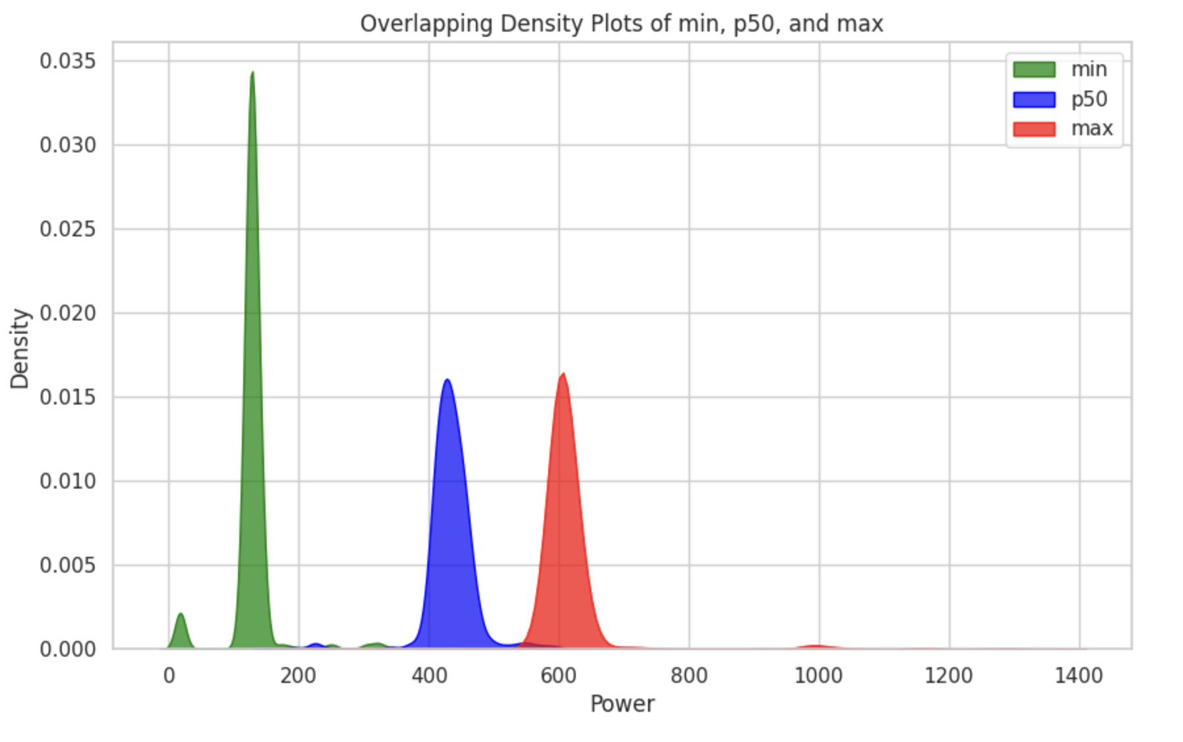
Energy Inefficiencies in Nodes

Slide 4
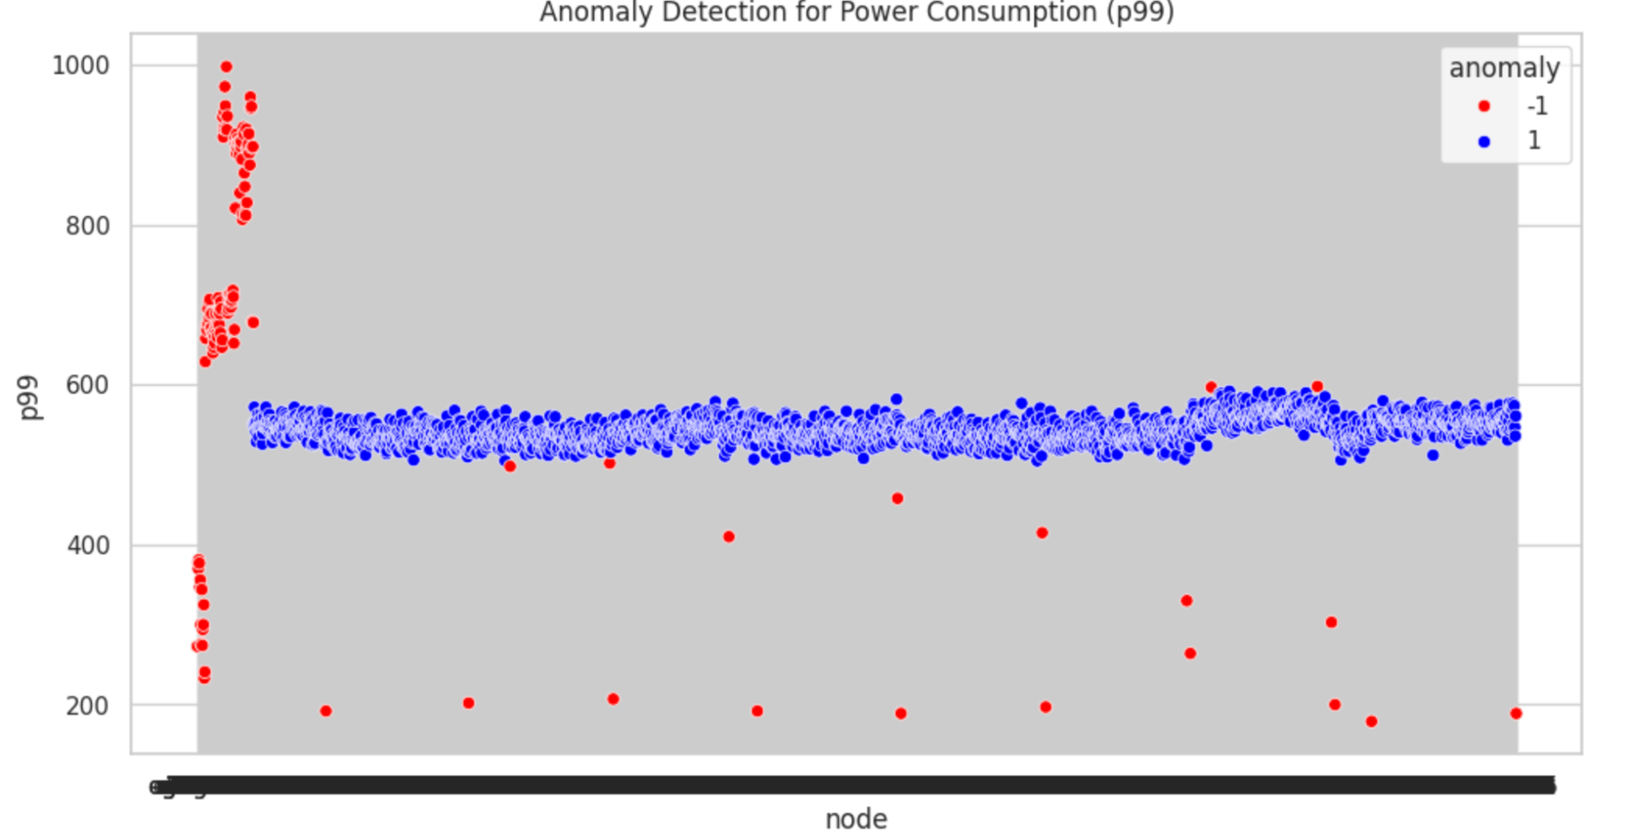
Energy Inefficiencies in Nodes

Slide 5
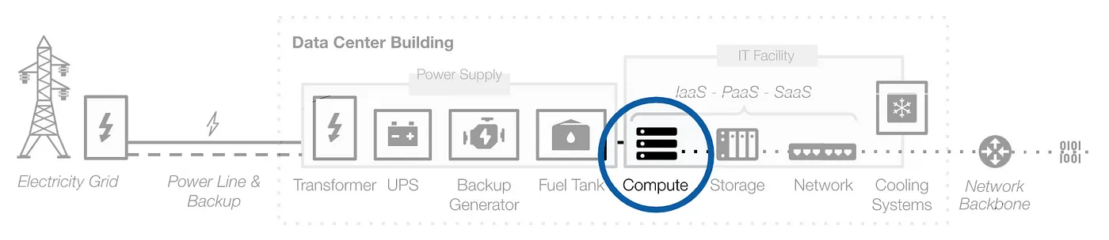
Cloud Computing optimizes energy and efficiency
Energy Efficiency
Dataset
Real world data centers lack the same scale and energy efficiency as cloud-based data centers, which are optimized for energy efficiency and hosting several servers.
Dataset on carbon footprint of different AWS EC2 (Elastic Compute Cloud) instances
Notes:
Shifting computing operations to the cloud can significantly reduce energy consumption and emissions by 25% to 50%. Cloud data centers are optimized for energy-saving and hosting several servers.
, which tend to be older and smaller, lack the scale to justify or implement the latest energy-efficient cooling and power distribution technologies. (page 6)

Slide 6
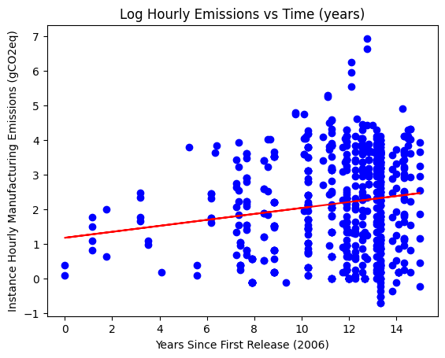
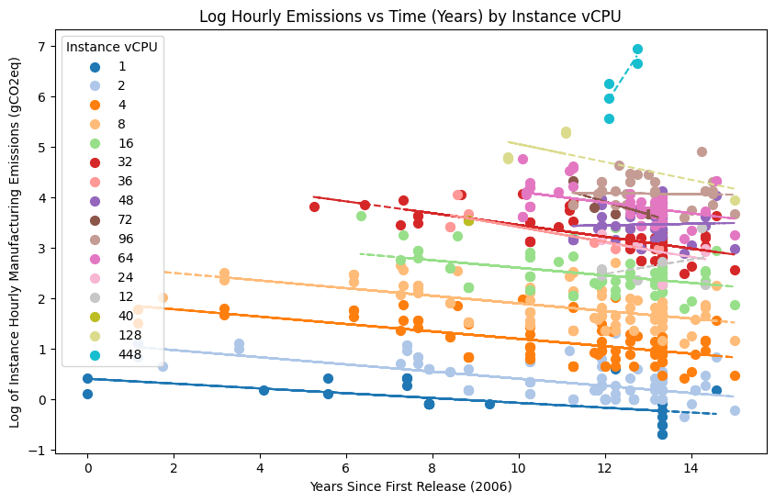
Emissions decrease as we innovate cloud computing
Notes:
We initially see the impact of innovation through time masked in the original linear regression model, where as time increases, log hourly emissions increases
We can see that as time progresses, even with more advancement in the instance types, the log hourly emissions generally decrease. This is more uncertain for larger vCPU counts, especially with 448 CPUs having an increase in log hourly emissions.

Slide 7
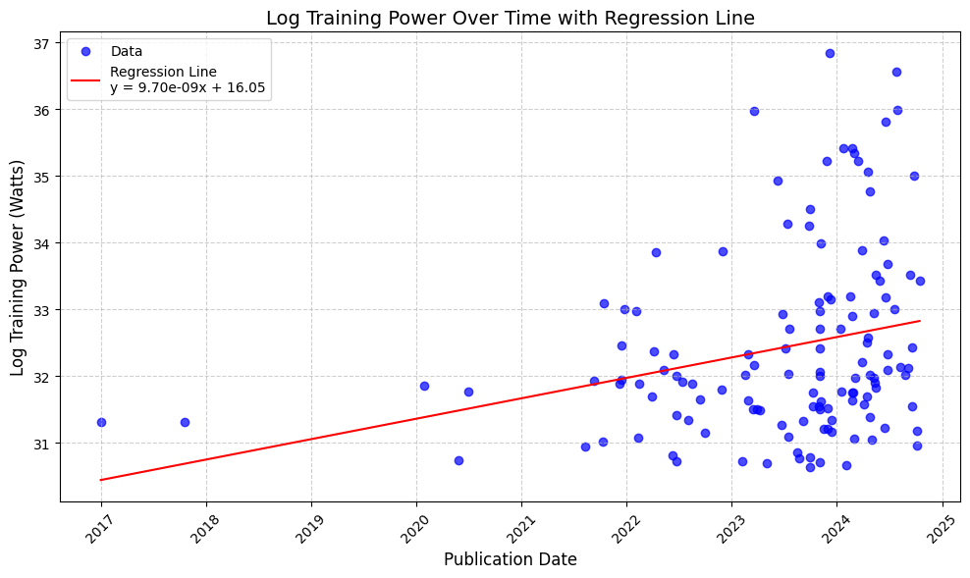
AI Models Dataset
Main Trend:
Variables related to increased AI model complexity (parameters, dataset size, etc) and Training power use increases with publication date.

Slide 8
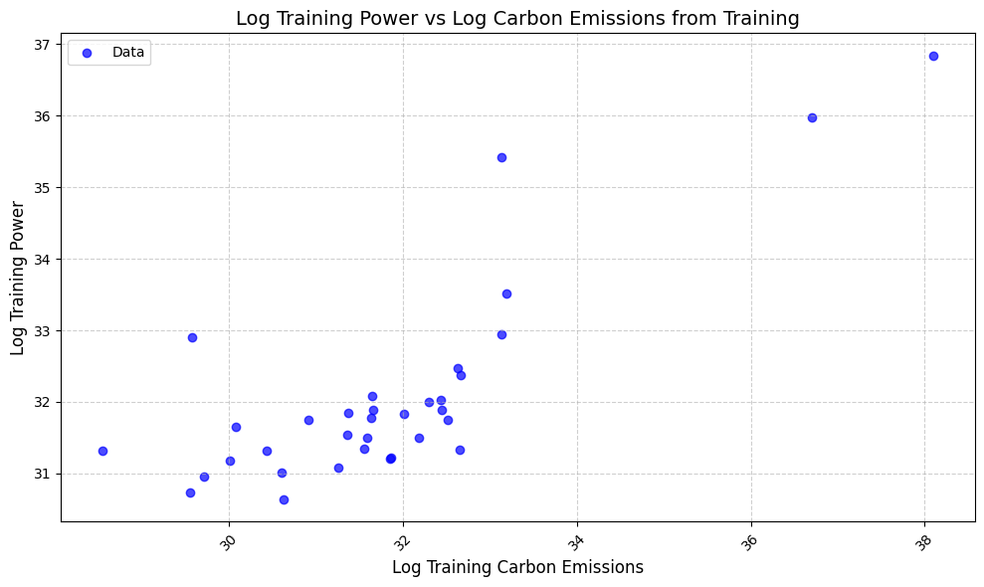
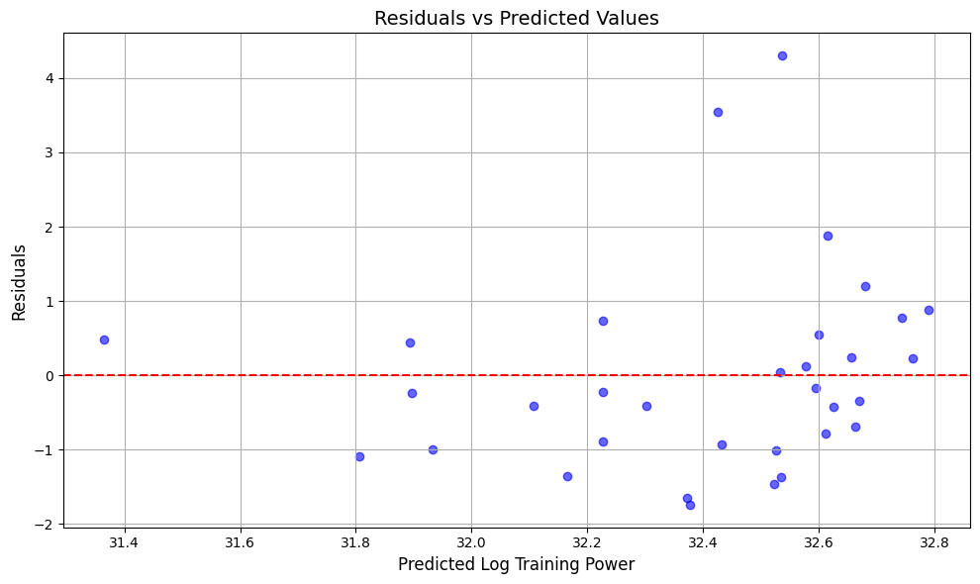
Model Parameters: 130 data points, Linear Regression, testing size of 25%
Label: Log(Training Power (Watts)), proxy for CO2 Emissions
Features: Publication Date, Log FLOPs, Log Training dataset size (datapoints), Log(# of Parameters)

Slide 9
So what can we do?
Cloud-based Data Centers
Sustainable Computing
Efficient ML Model Architectures
Promote Green AI and Green by AI

Slide 10
Sources
https://www.bny.com/content/dam/bnymellon/documents/pdf/2023-sustainability-report.pdf
https://www.sciencedirect.com/science/article/pii/S0925231224008671
Data:
https://docs.google.com/spreadsheets/d/1DqYgQnEDLQVQm5acMAhLgHLD8xXCG9BIrk-_Nv6jF3k/edit?gid=224728652#gid=224728652
https://medium.com/teads-engineering/building-an-aws-ec2-carbon-emissions-dataset-3f0fd76c98ac
https://github.com/NREL/BUTTER-E-Empirical-analysis-of-energy-trends-in-neural-networks-supplementary-code/blob/main/Readme%20for%20Data.md#slurm_node_sinfocsv

Slide 11
Thank You!

